Slide 1


Coding the Collection:
Sprint 3 Demo
Team: Will Ye, Edward Zhuang, Sam Chan, Santo Grillo
Clients: Julia McHugh, Mark Olson

Slide 2
Demo
Sam: Display All Projects/Edit Project/Delete Project/Projects/Image Storage
Santo: Presentation/Collapsable Menus
Eddie: User Registration/Sign In, Session Handling, Protecting Routes
Will: Add/Edit Artworks, Routing (URLs), Async

Slide 3
Value
We wanted to focus on basic functionality that met our clients’ highest priority needs
Most important:
Project, Artwork, Presentation pages connected to the backend data store
Authentication for users (protected routes, session handling)
Raw basic application without stylization, beautification, etc.
Notes:
Eddie

Slide 4
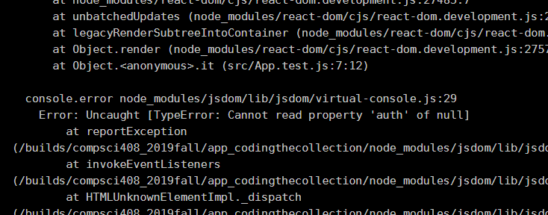
Testing Results
Automated test kept failing
Manual testing: go through entire creation lifecycle

Slide 5
Release Management
Master branch represents production build
Development happens on separate branches
Deployment on VCM
Eventually, automatic build and deployment

Slide 6
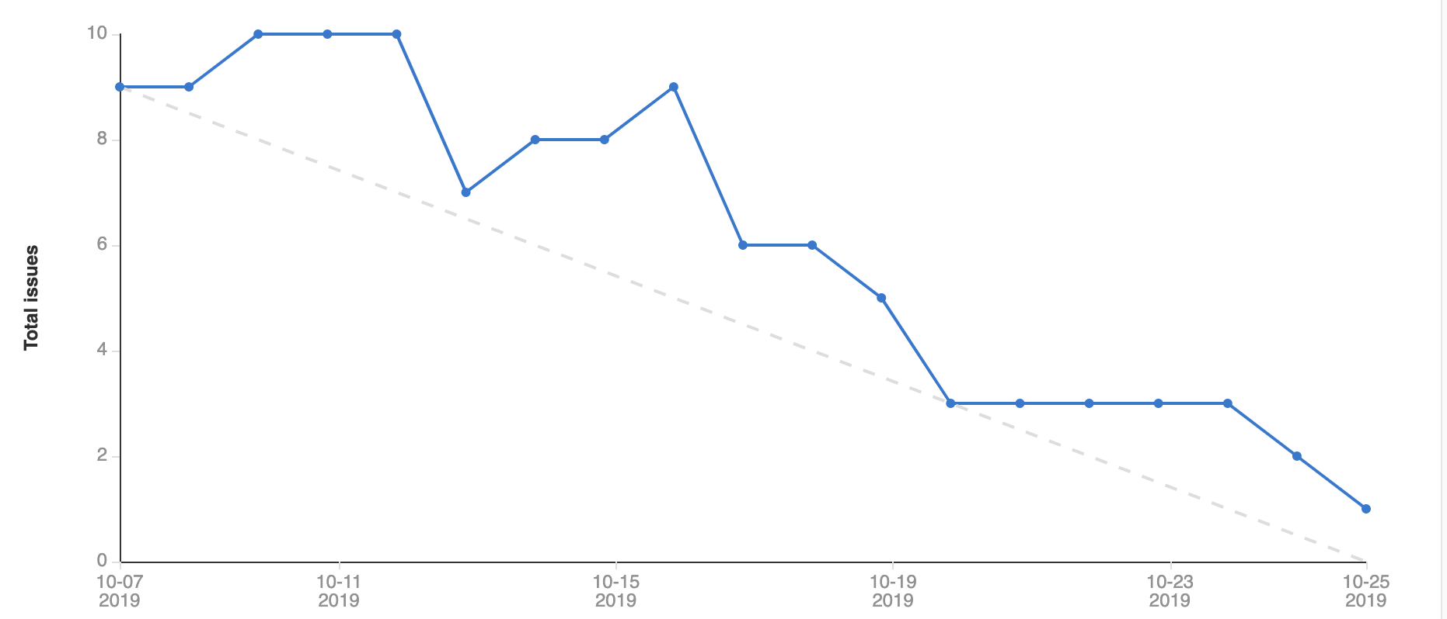
Burndown Chart

Slide 7
Timeline
Week 1
Set up Firebase storage
Implement User Authentication
Implement Projects Logic
Week 2
Re-stylize specific pages
Implement Artwork Logic
Implement Presentation Logic
Notes:
First thing we did was set up back end storage system to hold all of our data, including: Images and user accounts.
We decided to use firebase, as it would be a flexible cloud option and it provided a well documented solution for user authentication
We also use their realtime database to store all artworks and projects.
After we set up the Firebase foundation, we began to work on implementing user authentication.
Also worked on implementing projects logic, and everything related to it.

Slide 8
Retrospective
What worked:
Scheduling meetings with clients using When2meet
Getting together to work in person
What did not work:
Communication was not always effective
Difficulty providing accurate time estimates/scoping for issues (both internal and external)
General framework components do not meet client-specific requirements
Notes:
Taking advantage of online scheduling tools to find times in our busy schedules.
Communication was so much easier in person than over slack. Also, everyone can sit down and be focused for extended periods of time.
We could have been more vocal with each other on Slack, discussing our blockers and what we had accomplished so far. Also sometimes we didn’t respond to messages we sent each other.
Said we would get things done by certain time (ex. “I’ll get this done by friday”), but often failed to complete tasks in estimated time frame.

Slide 9
Planning Next Sprint (Sprint 4)
Key Tasks:
Fix all issues not fully implemented in Sprint 3: Artwork Pages (Sam), authentication for projects (Edward, Will), complete UI for presentation page (Santo)
High code coverage, automated tests, CI/CD, pipeline for deployment
Looking Ahead Further: Stylization (with style guide), Beautification

Slide 10
Thanks for Listening!

